Slide 1


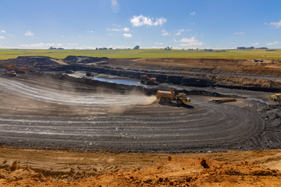
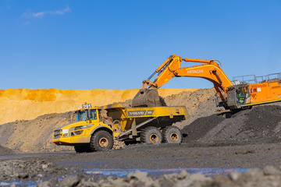


DEPARTMENT OF MINERAL AND PETROLEUM RESOURCES
Transformation of the Mining Industry
From Pre-1994 to Empowerment:
Navigating a Legacy and Shaping a Sustainable Future
Presented by - Ms Bongiwe Mabusela

Slide 2

Agenda
Historical context
The imperative for change
The legislative framework
Key factors of transformation
Successes
Current challenges
The future
Conclusion

Slide 3



Historical context
The mining industry as the economic backbone:
Massive foreign direct investment in South African Mining.
Apartheid legacy:
A society founded on racial segregation and economic apartheid.
Dispossession of land and mineral rights.
Profound socio-economic inequalities and conditions of poverty
This history demanded an imperative for reform post-1994
Migrant Labour System: Built on a system of cheap, black migrant labour predominantly from rural (labour sending) and Bantustan (homeland) areas.
A key pillar to economic contributions ( revenue, jobs, infrastructure etc.)

Slide 4

The imperative for change
The dawn of democracy demanded:
De-racialisation of the economy and redressing the imbalances of the past.
Address systemic inequalities, poor living conditions in mining communities and nutrition for employees.
Unlocks the potential of every willing participant and creates a more inclusive economy and ensures sustainable growth.
Global standing: Attracts investment by providing a security of tenure and aligning with global standards.

Slide 5

Legislative framework
Mineral and Petroleum Resources Development Act, 2002 (MPRDA)
The Mining Charter, 2004
A policy framework that records a pact between the government and industry, in which they committed themselves to a framework for progressing empowerment, thereby giving impetus to the MPRDA objectives.
Declared all mineral resources a common heritage of all South Africans and state being a custodian.
It has one of its primary objects – the transformation of the sector and empowerment of citizens who were previously excluded.
It provided security of tenure which plays a pivotal role in the achievement of transformation – without it there would be no further investment in mining.

Slide 6





Key factors of transformation
Mine community development
Contribute towards the socio-economic development of the areas in which they operate and implement sustainable projects.
Human Resources Development and Employment Equity
Targets for Black representation at all management levels
Invest in demand led skills and training

Slide 7

Key Factors of transformation, continued
Preferential Procurement and Enterprise & Supplier Development
Spend on capital goods and services from empowered entities.
Support black owned including youth and women to access economic opportunities.
Promote and drive Ownership and Equity
Requirement for a minimum HDSA ownership for all mining rights.

Slide 8

Progress and achievements
The impact of the mining industry realization of transformation as the right thing to do is undeniable.
A solid legislative framework with clear objectives to achieve transformation.
Significant shift in ownership patterns (a new class of black shareholders)
Improved racial and gender representation in Management and Boards
Increased procurement from black owned suppliers and manufacturers.
Huge amount invested towards the Social and Labour Plan projects
The culture has shifted than pre-1994

Slide 9

Current challenges
Fronting: ownership and control do not rest with HDSA’s.
Unintended consequences:
Some empowerment deals left beneficiaries with debt rather than sustainable wealth.
Structural economic challenges
Job losses due to many factors
Community tensions which has been displayed through the emergence of many forums.
Extortionists, Mafia

Slide 10
New frontier
Global competitiveness:
to attract investment a balanced approach is needed which brings competitiveness, reliability and stability.
Embrace technology:
AI to improve efficiency, sustainability and safety.
Transformation is a core part of ESG - turning it into a competitive advantage

Slide 11
The Way forward
Transformation is an ongoing journey, not a destination. It is essential and non-negotiable.
Success requires collaboration between government, mining companies, communities and trade unions ( Stakeholder centric).
A balanced approach is necessary: Need to find a balance between empowerment and being global competitive.
A transformed, sustainable and innovative mine of the future is the ultimate goal.
We need laws that are not merely conformist and cloaked in the language of universality, but that address the issues of substantive equality.
We need the law that is premised from the lived experiences of South Africans especially those that are still marginalized.
It is the encounters of those who feel the dissonance that must be overcome.
We need to move beyond the lens of shareholders but to stakeholders.
Transformation should form part of those boardroom decisions

Slide 12
DMPR
DEPARTMENT OF MINERAL AND PETROLEUM RESOURCES
Thank You
Bongiwe.Mabusela@dmpr.gov.za

