Slide 1
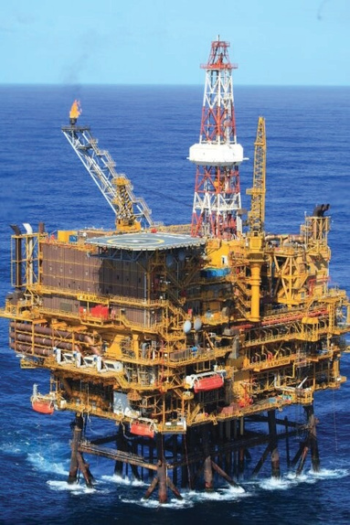

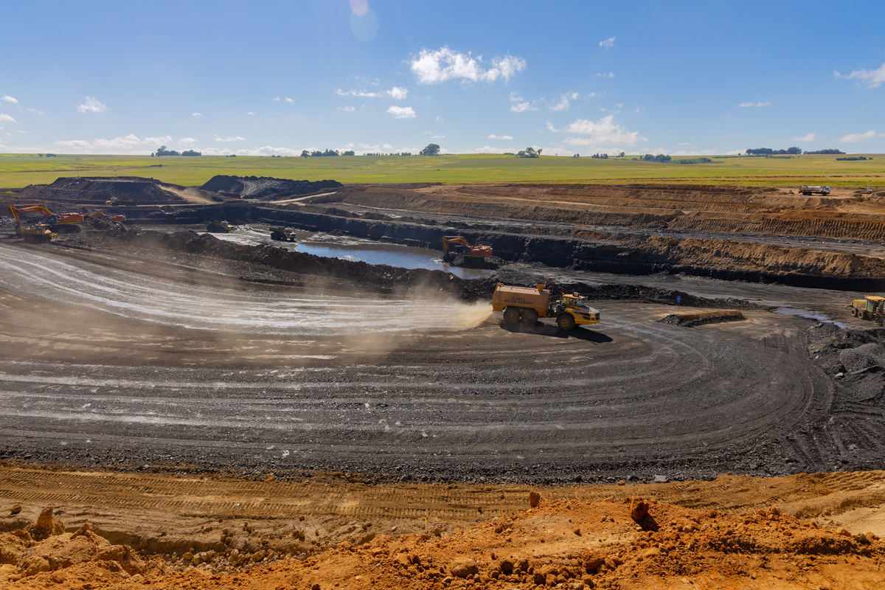
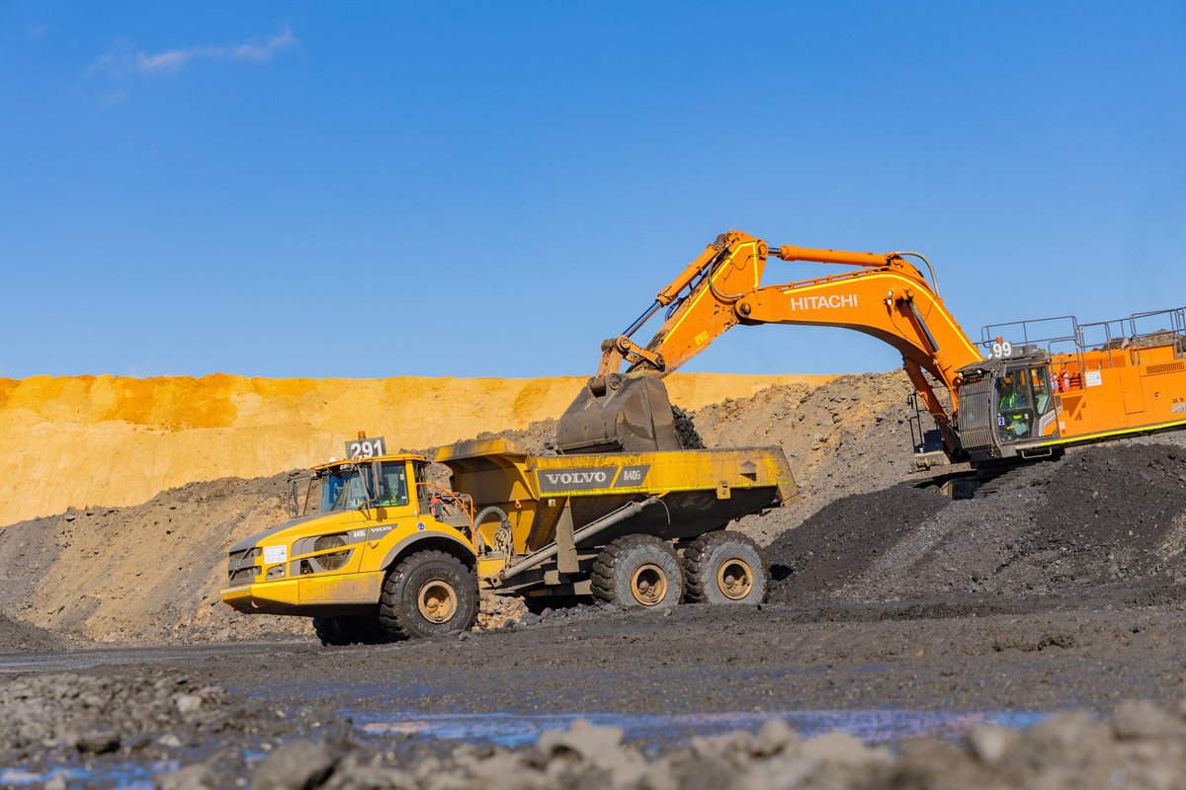



DEPARTMENT OF MINERAL AND PETROLEUM RESOURCES
Illegal Mining & Impact on the
Mining Sector
Adv Mmadikeledi Moloto
PRESENTED BY
Slide 1 |

Slide 2
Background
Minister
Director General
DDG: Mineral & Petroleum Regulation
DDG: Mine Health & Safety
Entities Reporting to Minister
Deputy Minister
DDG: Mining, Minerals & Energy Policy
DDG: Chief Financial Office
DDG: Corporate Services
DDG: Compliance
Slide 2 |

Slide 3
Legislative Framework
Slide 3 |

Slide 4

Legislative Framework
South African Mining Law is regulated by the Mineral and Petroleum Resources Development Act, 28 of 2002 (“MPRDA”) legislation dealing with acquisitions or rights to conduct reconnaissance, prospecting, and mining.
The MPRDA became effective on 1 May 2004 and substituted the erstwhile hybrid system of a common law system with statutory regulation.
National Environmental Management Act, 1998 regulates environmental management in the conduct of mining activities
There are several other key pieces of complementary legislation
  Mineral and Petroleum Resources Royalty Act, 2008, regulates royalties' management.
Slide 4 |

Slide 5
Legislative Framework
Mining Titles Registration Amendment Act, 2003 - title registration
Mine Health and Safety Act, 1996 - health and safety in mines
Diamonds Act, 1986
Precious Metals Act, 2005.
Slide 5 |

Slide 6
Sector Regulation
Slide 6 |

Slide 7
The Legal Framework on Operating Mines and their in terms of the Mineral & Petroleum Resources Development Act (Prohibition)
The MPRDA, currently under review, introduced an obligation on holders of rights/permits to rehabilitate their operations and conduct concurrent rehabilitation to reduce the environmental liability during closure, when they apply for a closure certificate. In addition, they are expected to fund their own rehabilitation and provide a rehabilitation fund for that purpose.
Section 5A- prohibition relating to illegal act,
No person may prospect for or remove, mine, conduct technical co-operation operations, reconnaissance operations, explore for or produce any mineral or petroleum or commence with any work incidental thereto on any area without-
  an environmental authorization;
  a reconnaissance permission, prospecting right permission to remove, mining right, mining permit, retention permit, technical co-operation permit, reconnaissance permit, exploration right or production right, as the case may be;
  Giving the landowner or lawful occupier of the land in question at least 21 days written notice.
Slide 7 |

Slide 8
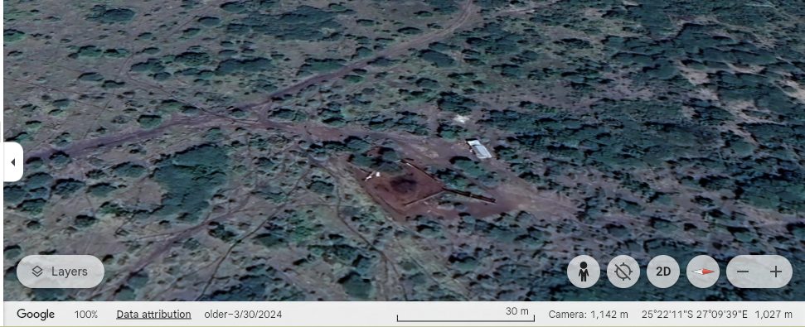
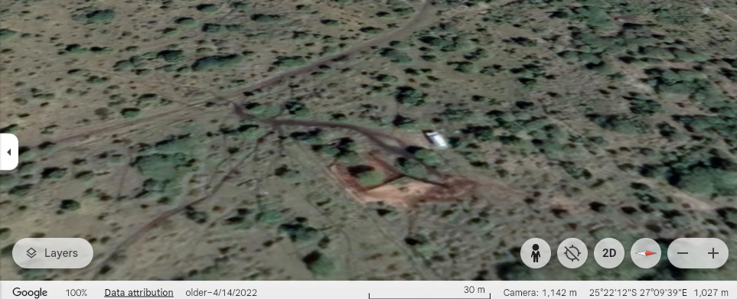
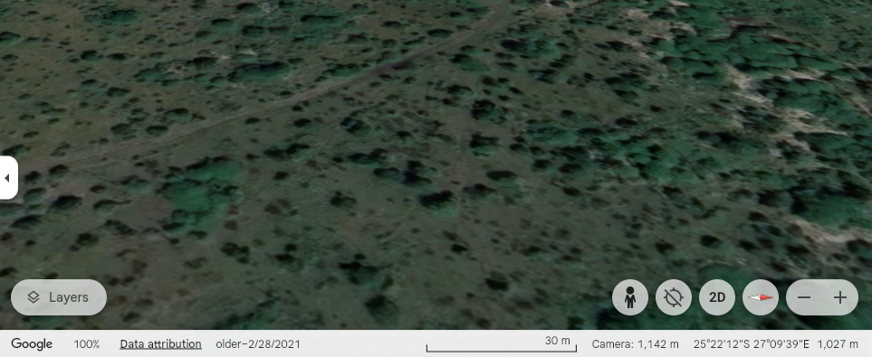
2024
Sector Compliance Monitoring
2022
2020
Slide 8 |

Slide 9
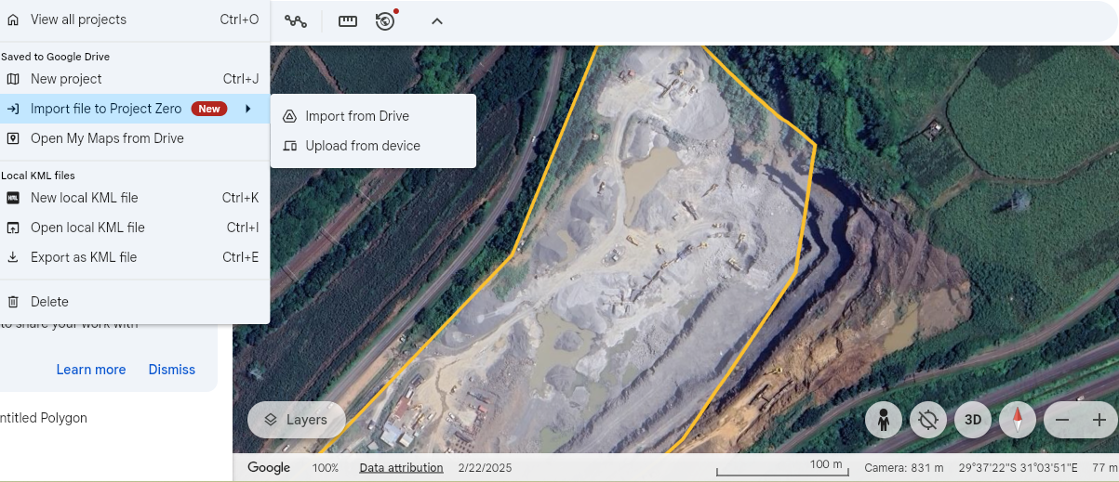
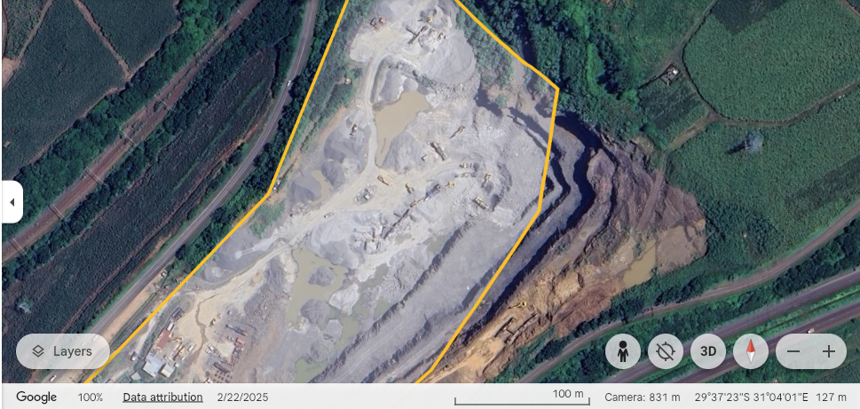
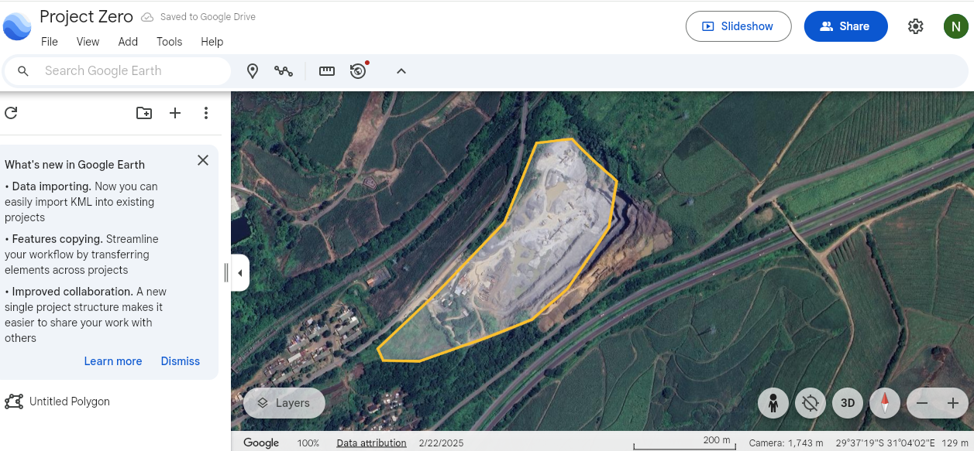

Slide 10
Collaboration and Partnership with
Law Enforcement Agencies
Slide 10 |

Slide 11
Dealing with Illegal Mining
Illegal mining is a criminal activity mainly carried out by armed criminal syndicates. It poses a serious threat to national security, as well as the country's economic and social stability. All South Africans, including those in the corporate sector, must unite in efforts to prevent and eradicate illegal mining. It has become clear that no single agency can combat these crimes alone, and that a multidisciplinary, intelligence-led, and integrated approach is our strongest tool.
The South African mining industry faces a significant challenge from illegal mining, predominantly perpetrated by illegal miners from neighbouring countries. This illicit activity occurs both underground and on the surface, posing considerable risks and hazards. Organised criminal groups exacerbate the problem, contributing to various offences and escalating violence.
The roots of the problem are complex and include factors such as unemployment, exploitation by criminals, the expansion of syndicate territories for financial gain, and neglected properties within the mining sector due to cost-cutting measures.
The high levels of illegal mining currently experienced across South Africa are severely affecting safety and security, as well as harming the economy.
The undeniable reality is that those involved in illegal mining show no regard for the safety and security of others, nor for the integrity of our infrastructure. They disregard the laws that govern the mining and minerals of the country.
Slide 11 |

Slide 12
Dealing with Illegal Mining
Illicit mining is associated with intimidation, proliferation of illegal high-caliber firearms, human trafficking, as well as the involvement of foreign nationals in illicit mining and the trafficking of precious metals.
The phenomenon impacts across various sectors and clusters of government and threatens national security, the government’s authority as well as the economy and society. Illegal mining further culminates in the trafficking of precious metals and is linked to illegal trade in arms and explosives, as well as human smuggling and trafficking.
Beyond immediate threats to safety, illegal mining inflicts severe environmental consequences, compromising water sources, polluting ecosystems, and leaving landscapes scarred.
The cycle of illegal mining sustains itself through a network of supply and demand, with apprehended miners shielding their handlers. Effectively, addressing the issue requires a comprehensive approach, considering social, economic, environmental, and law enforcement dimensions
Slide 12 |

Slide 13
Dealing with Illegal Mining
The Department will continue to have direct interest in this regard as illegal mining encroaches in the space in which it regulates.
Although a comprehensive cost assessment has not yet been conducted, illegal mining constitutes a multi-billion-rand industry that poses significant threats to national security, government authority, and socio-economic development.
The fleecing of national strategic assets and resources negatively impacts economic growth and development, resulting in substantial losses in government revenue. This decline also affects business revenue, thus threatening the long-term sustainability of legally operating mines and their secondary industries.
In response to the scourge of illegal mining, the Government has implemented a multi-disciplinary enforcement strategy targeting hotspots provinces, including Limpopo, Gauteng, Mpumalanga, Free State, Northern Cape, and the North West.
Slide 13 |

Slide 14
Dealing with Illegal Mining
The department established partnerships with law enforcement authorities (SAPS, National Prosecuting Authority, Asset Forfeiture Unit, Financial Intelligence Centre, State Security Agency), other government departments, including Immigration, South African Revenue Service, and Customs.
Participate in multistakeholder enforcement forums and structures (National Co-ordinating Strategic Management Team (NCSMT), National Organised Crime Unit (NOC), Provincial Organised Crime Unit (POC), National Joint Operational and Intelligence Strategic(NATJOINTS).
A need was identified to provide training to the detectives and prosecutors on mining and mineral legislation and criminality surrounding minerals.
There are workshops and advocacy campaigns that inform and educate the public about the work of the department and encourage them to report any suspicious mining activities.
The NPA has identified the need to address the limited experience to effectively deal with these prosecutions, as there is no established unit or divisional level to prosecute mining and minerals crimes.
Slide 14 |

Slide 15
Dealing with Illegal Mining
Government continues with a fight against illegal mining through initiatives such as Operation Vala Umgodi which continues to help us deal decisively with illegal mining.
To demonstrate how seriously the Government views illegal mining, it has dedicated over R2 billion in a fight against illegal mining for a period of over a year through the Vala Umgodi.
Since the inception of the operation Vala Umgodi in December 2023, approximately 3 263 personnel across relevant Departments (SAPS, SANDF, DHA, SARS and DMPR) participated in the operation.
A total of 22 227 cases were opened, and 27 275 suspects were arrested. A total of 5826 suspects were found guilty and various other cases are still pending before courts.
These cases relate to charges ranging from possession of gold bearing materials, mining contraventions in terms of section 5(A) of the Minerals and Petroleum Developments Act, 28 of 2002, theft and attempted theft of minerals, trespassing on mining premises, possession of explosives and contravention of section 49 of the Immigration Act.
The MPRDA is currently under review to make unauthorized mining a criminal offense by increasing the penalties and fines.
Slide 15 |

Slide 16
Dealing with Illegal Mining
This issue has also garnered the attention of the Justice, Crime Prevention and Security Cluster (JCPS), led by the Presidency, to demonstrate the government's serious commitment to addressing this problem.
The Department is already represented and actively participates in various structures established by the South African Police Service at the National, Provincial, and Local levels.
As a result of these interventions, we have noticed a marked decrease in illegal mining activities. However, the challenge subsists, albeit at a reduced rate.
Our Department continues to form part of all efforts driven by law enforcement to deal with the scourge it has on the country and the economy
Slide 16 |

Slide 17
CHALLENGES | PROPOSED INTERVENTIONS
1. Limited investigative capacity on mining and minerals related crimes. | 1. Training of law enforcement on mining and minerals crimes is currently underway. Possibility of specialised courts to deal with mining and minerals-related crimes, including a dedicated Unit within SAPS.
2. Gang violence due to unsafe mining practices causes social instability and environmental harm. | 2. Law enforcement capacity is essential to maintain law and order.
3.Disjointed legislation | 3. Policy and legislative review are currently underway to ensure alignment.
4. Abuse of prospecting rights, and multiple permits in the same area. | 4. Building internal capacity through technical support and improved resources is vital for effective monitoring and enforcement..
5. The safety of department officials during site visits. | 5. Priority and additional financial resources to create a safe environment.
6. Limited capacity within the department to conduct effective monitoring and enforcement. | 6. The alignment of the department structure to the mandate is currently underway.
Slide 17 |

Slide 18
Thank you
Mmadikeledi Moloto: Deputy Director-General: Compliance
Mmadikeledi.moloto@dmpr.gov.za
www.dmpr.gov.za
082 446 6038
Trevenna Campus
71 Meintjies Street
Arcardia
www.dmpr.gov.za
012 444 3000
Slide 18 |

